Slide 1
Forces
YEAR 10 PRE-ATAR SCIENCE

Slide 2
Learning Intention
The motion of objects can be described and predicted using the laws of physics

Slide 3
Success criteria
Define force
Describe effects of forces
Give examples of different types
Classify forces as contact or non-contact

Slide 4
Key words
force
effect
contact/non-contact force
friction
gravitational
newton (N)

Slide 5
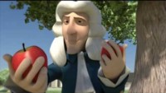

Slide 6

What is a force?
Forces are pushes or pulls.
Forces can include twisting (torsion, torque), compression, tension, impact, shear etc

Slide 7
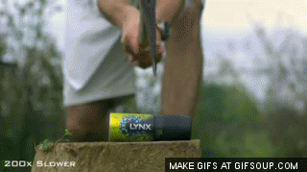
What can forces do?
The effects of forces are:
change in motion of an object
  speed up
  slow down
  change direction
change the shape of an object

Slide 8
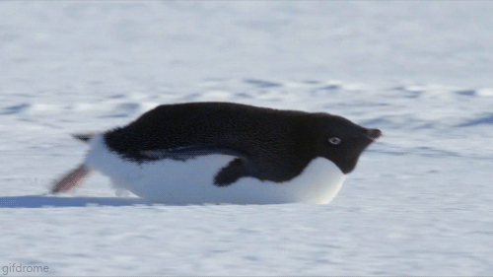
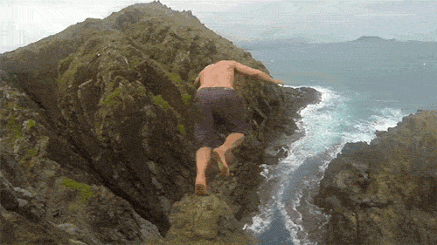
What types of forces are there?
Contact forces: objects have to be touching for them to have an effect
  friction
  adhesion
  cohesion
Non-contact forces: force can act at a distance
  gravity
  magnetism

Slide 9
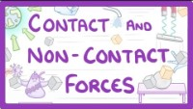

Slide 10
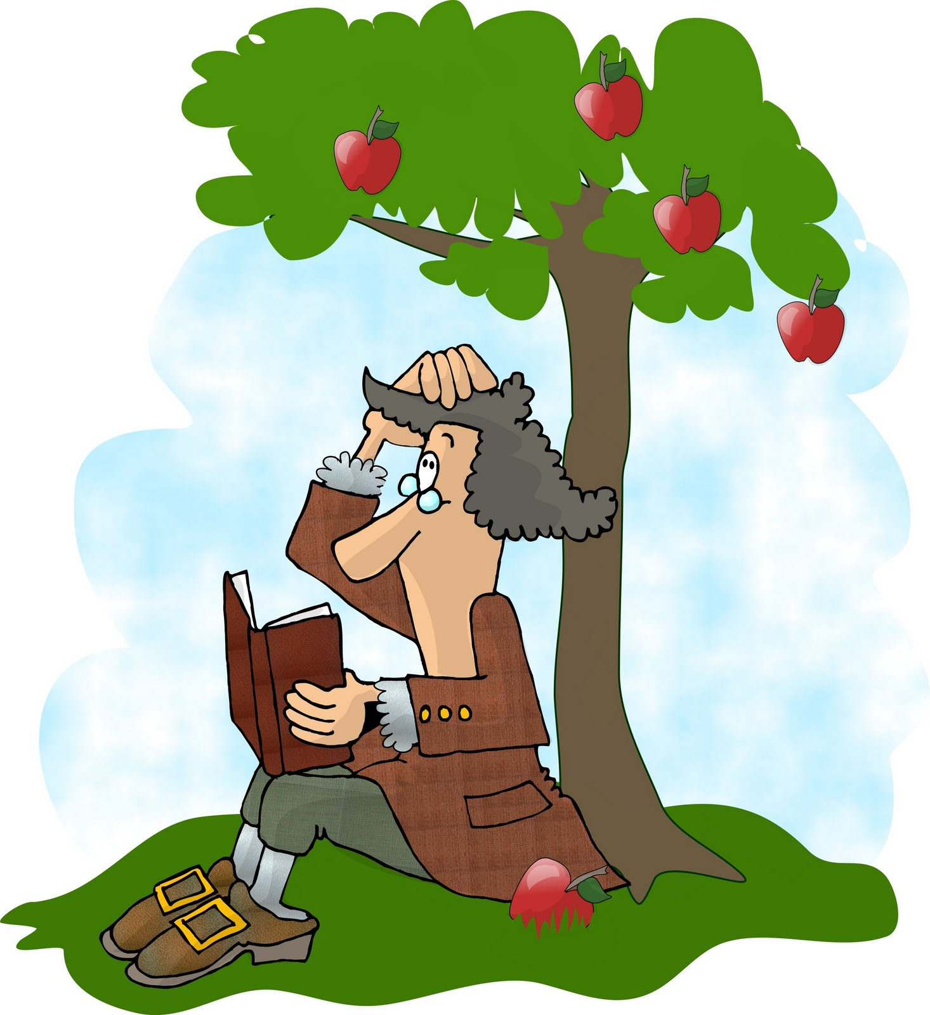
How do we measure forces?
Forces are measured in newtons (N)
1 newton (N) is how much force you need to lift 100g (a small apple) on Earth

Slide 11
How can we represent forces?
Forces are vector quantities. This means they have magnitude (size) and direction.
We can represent a force with an arrow
5N

Slide 12
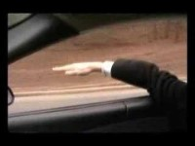

Slide 13
Success criteria
Define force
Describe effects of forces
Give examples of different types
Classify forces as contact or non-contact

Slide 14
Next time…
Find out what happens when there is more than one force acting on an object
Determining resultant force by vector resolution

